Slide 1
Fundamentals of CRE
Chemical Reaction Engineering
By
Dr Salah N. Farhan
Senior lecturer. Chem. Eng. Dept.
College of Engineering
University of Diyala
Salah N. Farhan College of Engineering Diyala University

Slide 2
Fundamentals of CRE
Chapter 14: Enzyme Kinetics
Salah N. Farhan College of Engineering Diyala University

Slide 3
Enzymatic Reactions
  Michealis-Menten Kinetics
  Lineweaver-Burk Plot
  Enzyme Inhibition
    Competitive
    Uncompetitive
    Non-Competitive

Slide 4
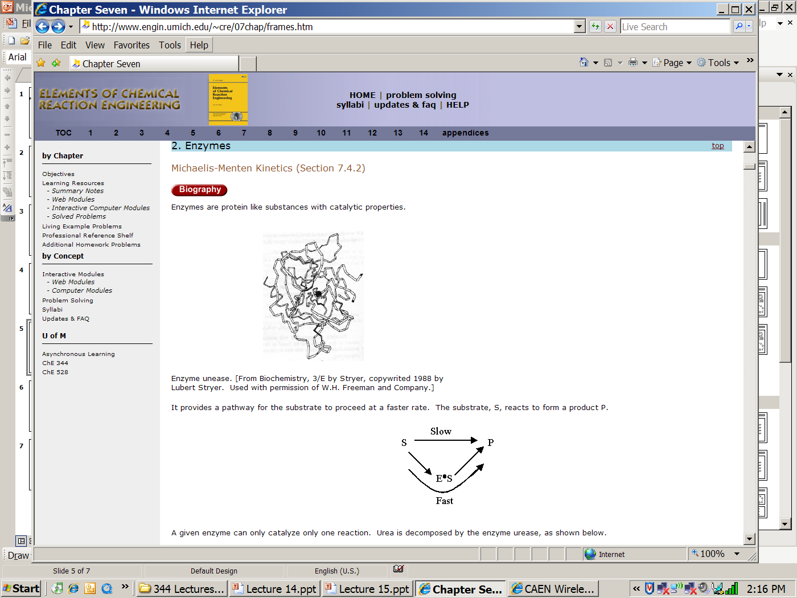
Enzymes
Michaelis-Menten Kinetics
Enzymes are protein-like substances with catalytic properties.
Enzyme Unease
[From Biochemistry, 3/E by Stryer, copywrited 1988 by Lubert Stryer. Used with permission of W.H. Freeman and Company.]

Slide 5
Enzymes
Enzymes provide a pathway for the substrate to proceed at a faster rate. The substrate, S, reacts to form a product P.
Slow
S
P
Fast
A given enzyme can only catalyze only one reaction. Example, Urea is decomposed by the enzyme urease.

Slide 6
Enzymes - Urease
A given enzyme can only catalyze only one reaction. Urea is decomposed by the enzyme urease, as shown below.
The corresponding mechanism is:

Slide 7
Enzymes - Michaelis-Menten Kinetics

Slide 8
Enzymes - Michaelis-Menten Kinetics

Slide 9
Enzymes - Michaelis-Menten Kinetics
V_{max}=k_{cat}E_{t}
Turnover Number: k_{cat}
Number of substrate molecules (moles) converted to product in a given time (s) on a single enzyme molecule (molecules/molecule/time)
For the reaction:
k_{cat}
H₂O₂ + E →H₂O + O + E
40,000,000 molecules of H₂O₂ converted to product per second on a single enzyme molecule.

Slide 10
Enzymes - Michaelis-Menten Kinetics
Michaelis-Menten Equation
(Michaelis-Menten plot)
V_{max}
Solving:
K_{M}=S_{1/2}
therefore K_{M} is the concentration at which the rate is half the maximum rate.
-r_{s}
S_{1/2}
C_{S}

Slide 11
Enzymes - Michaelis-Menten Kinetics
Inverting yields:
Lineweaver-Burk Plot
1/-r_{S}
slope = K_{M}/V_{max}
1/V_{max}
1/S

Slide 12



Types of Enzyme Inhibition
Competitive
Uncompetitive
Non-competitive

Slide 13
Competitive Inhibition

Slide 14
Competitive Inhibition
1) Mechanisms:

Slide 15
Competitive Inhibition
2) Rate Laws:

Slide 16
Competitive Inhibition

Slide 17
Competitive Inhibition
From before (no competition):
Increasing C_{I}
Competitive
No Inhibition
Competitive
Intercept does not change, slope increases as inhibitor concentration increases

Slide 18
Uncompetitive Inhibition

Slide 19
Uncompetitive Inhibition
Inhibition only has affinity for enzyme-substrate complex
Developing the rate law:
(1)
(2)

Slide 20
Adding (1) and (2)
Uncompetitive Inhibition
From (2)

Slide 21
Uncompetitive Inhibition
Total enzyme

Slide 22
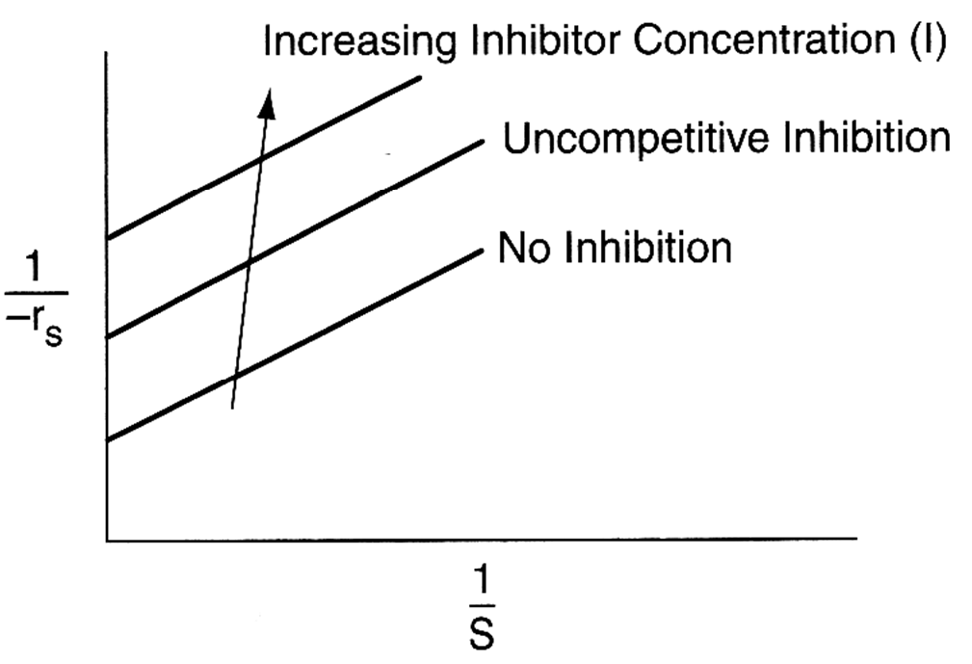
Uncompetitive Inhibition
Slope remains the same but intercept changes as inhibitor concentration is increased
Lineweaver-Burk Plot for uncompetitive inhibition

Slide 23
Non-competitive Inhibition

Slide 24
Non-competitive Inhibition
E + S E·S P + E
(inactive)I.E + S I.E.S (inactive)
+I
-I
-I
+I
Increasing I
No Inhibition
Both slope and intercept changes

Slide 25
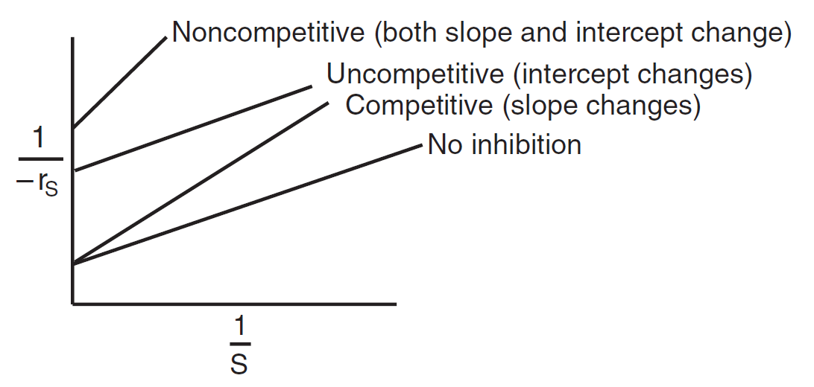
Summary: Types of Enzyme Inhibition
Lineweaver–Burk plots for three types of enzyme inhibition.

Slide 26
Bioreactors
  Monod Equation
  Yield Coefficients
  Washout

Slide 27
Enzymes - Urease
Review Last Lecture
A given enzyme can only catalyze only one reaction. Urea is decomposed by the enzyme urease, as shown below.
The corresponding mechanism is:
Michaelis Menten Equation

Slide 28
Bioreactors
cells
more cells
+ Products
Nutrient (S) +

Slide 29
Bioreactors

Slide 30
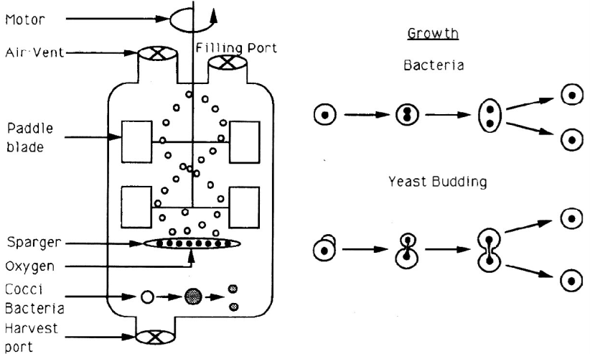
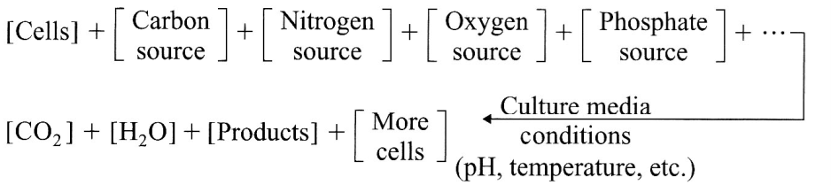
Batch Bioreactor

Slide 31
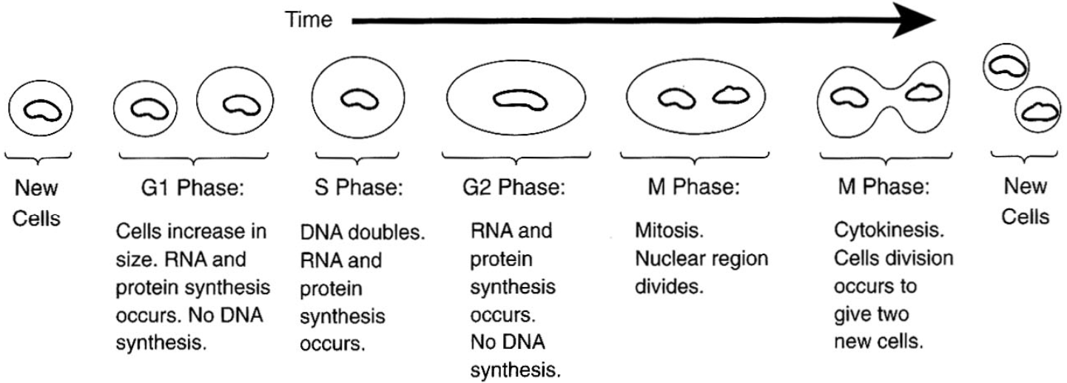
Phases of Cell Growth and Division

Slide 32
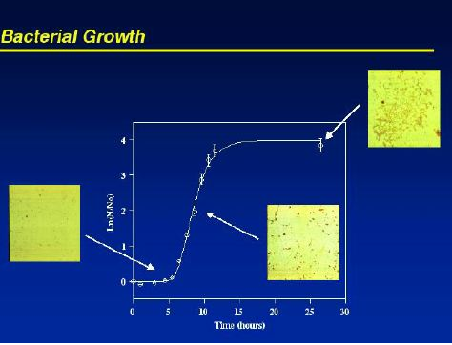
Bioreactors
inoculum
t=0 time →
Cells + Substrate → More Cells + Product

Slide 33
Bioreactors
Phases of bacteria growth:
I. Lag II. Exponential III. Stationary IV. Death
b) Monod growth rate law:
Lag Phase
lnC_{c}
Stationary Phase
Death Phase
Exponential Growth Phase
0
time

Slide 34
Bioreactors
1) Mass Balances
Accumulation = [In] - [Out] + [Growth] - [Death]

Slide 35
Bioreactors
Rate Laws:
C_{p}*= Product concentration at which all metabolism ceases

Slide 36
Bioreactors
3) Stoichiometry
A) Yield Coefficients
B) Maintenance

Slide 37
Bioreactors
3) Stoichiometry
Rate of Substrate Consumption
Can’t separate substrate consumption used for cell growth from that used for product formations during exponenial growth.

Slide 38


Bioreactors
v₀
C_{S0}
Volume=V
v
C_{C}
C_{S}
V=V₀
1) Mass Balance:

Slide 39
Bioreactors

Slide 40
Bioreactors
2) Rate Laws:
3) Parameters

Slide 41
Polymath Setup
1.) d(C_{C})/d(t)=-D*C_{C}+(r_{g}-r_{d})
2.) d(C_{S})/d(t)=-D*(C_{S0}-C_{S})-Y_{sg}*r_{g}-m*C_{C}
3.) d(C_{P})/d(t)=-D*C_{P}+Y_{PC}*r_{g}
4.) rg=(((1-(C_{P}/C_{pstar}))**0.52)*mumax*(C_{S}/(K_{S}+C_{S}))*C_{C}
5.) D=0.2
6.) k_{d}=0.01
11.) mumax=0.33
7.) r_{d}=k_{d}*C_{C}
12.) Y_{SC}=12.5
8.) C_{S0}=250
13.) K_{S}=1.7
9.) Y_{PC}=5.6
10.) m=0.3

Slide 42
Bioreactors – Chemostats - CSTRs
1. Steady State - Neglect Death Rate and Cell Maintenance
2. Cell

Slide 43
Bioreactors – Chemostats - CSTRs
3. Substrate

Slide 44
Bioreactors – Chemostats - CSTRs
CSTR Washout
C_{C}
C_{C}
D
D_{W}
Washout dilution rate

Slide 45
Maximum Product Flow Rate
DC_{C}
How does this figure relate to drinking a lot of fluids when you have an infection or cold?
D
D_{maxprod}
D_{W}

Slide 46
Fundamentals of CRE
Salah N. Farhan College of Engineering Diyala University

Slide 47
Fundamentals of CRE
Salah N. Farhan College of Engineering Diyala University

Slide 48
Fundamentals of CRE
Salah N. Farhan College of Engineering Diyala University

Slide 49
Fundamentals of CRE
Salah N. Farhan College of Engineering Diyala University

Slide 50
Fundamentals of CRE
Salah N. Farhan College of Engineering Diyala University

Slide 51
Fundamentals of CRE
Salah N. Farhan College of Engineering Diyala University

Slide 52
Fundamentals of CRE
Salah N. Farhan College of Engineering Diyala University

